Slide 1

Working with Images
Hrisheekesh R Senior Data Analyst, Attinad Software
www.attinadsoftware.com

Slide 2

Representing color and grayscale images as Tensors
Implementing image operations such as transpose, resize, cropping
Overview

Slide 3
Image Recognition

Slide 4
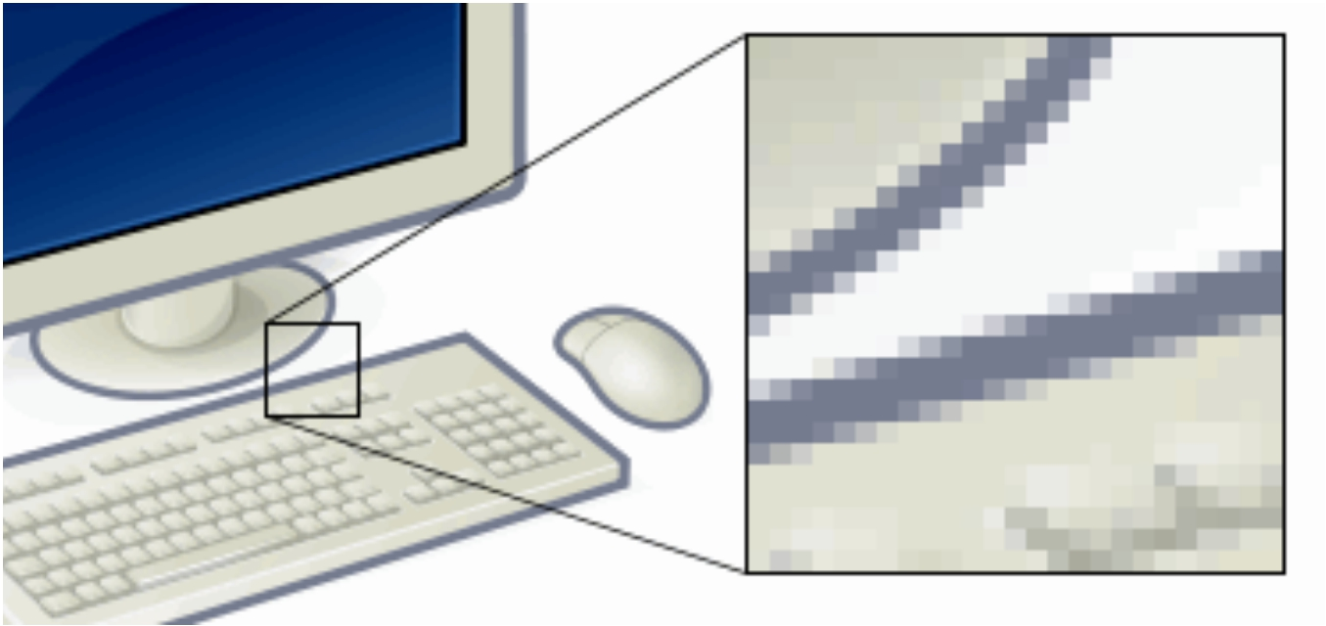
Pixels in Images
Copyright: Wikimedia commons, GFDL and cc-by-sa-2.5,2.0,1.0

Slide 5
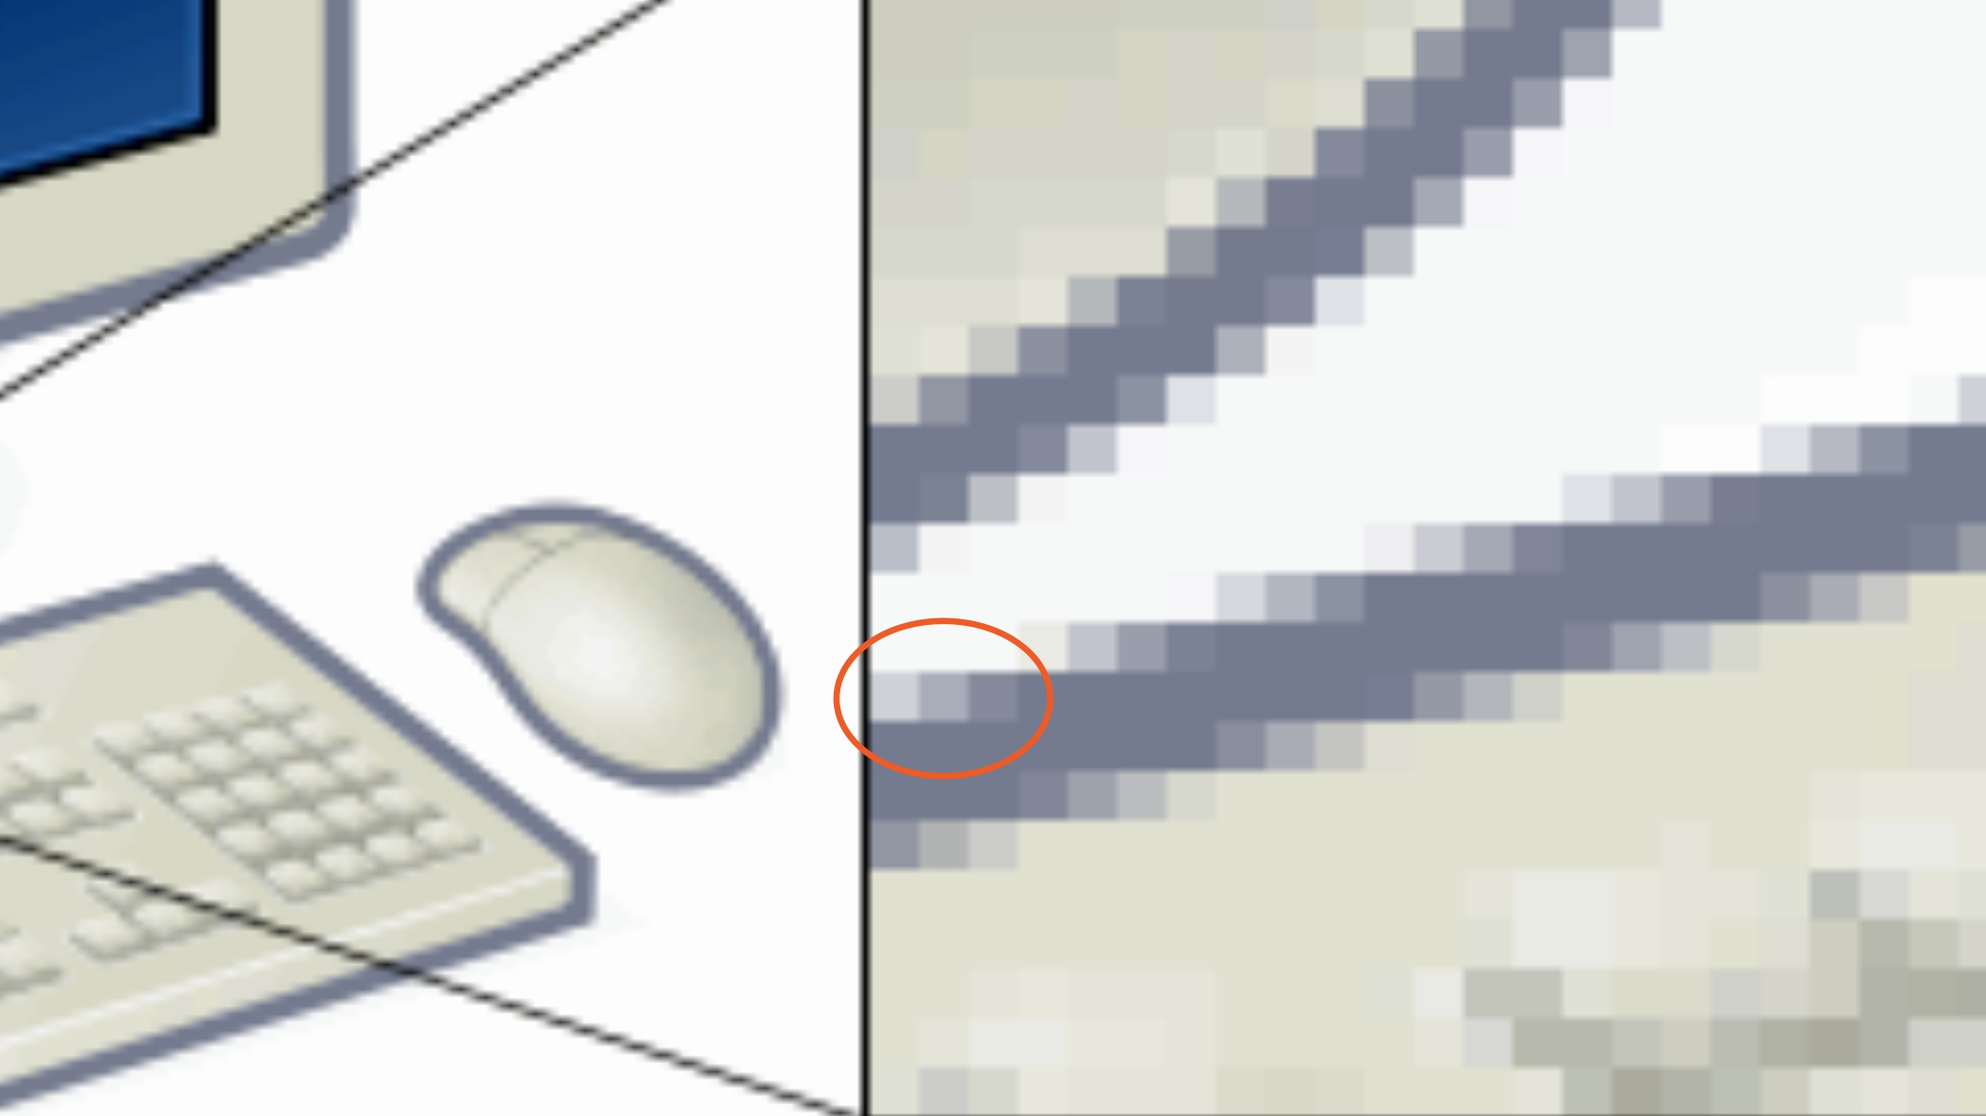
Pixels in Images
Copyright: Wikimedia commons, GFDL and cc-by-sa-2.5,2.0,1.0

Slide 6



Image Recognition
Images represented
as pixels
Identify edges,
colors, shapes
A photo of a
horse

Slide 7
Neural networks, specifically convolutional neural networks (CNNs) work well for hard
image recognition tasks

Slide 8
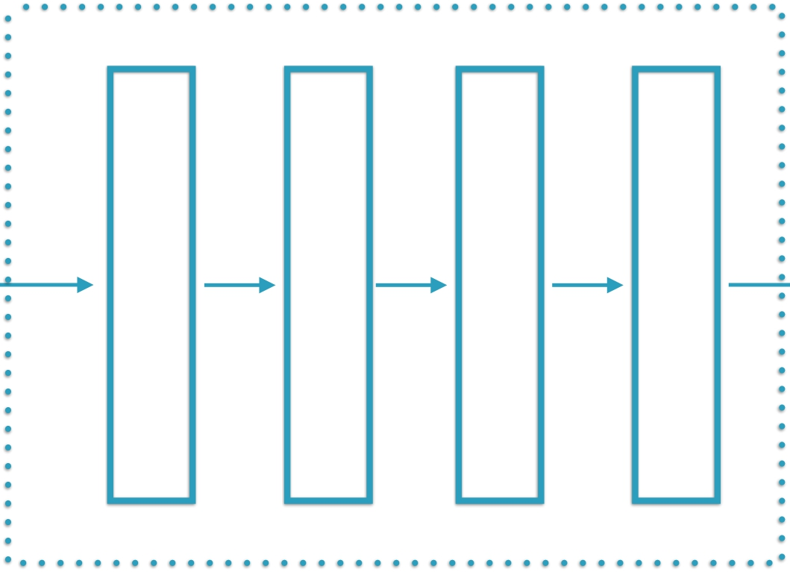


Image Recognition Using Neural Networks
Pixels
Edges
Corners
Object Parts
Corpus of
Images
Feature Selection &
Classification Algorithm
ML-based Classifier

Slide 9
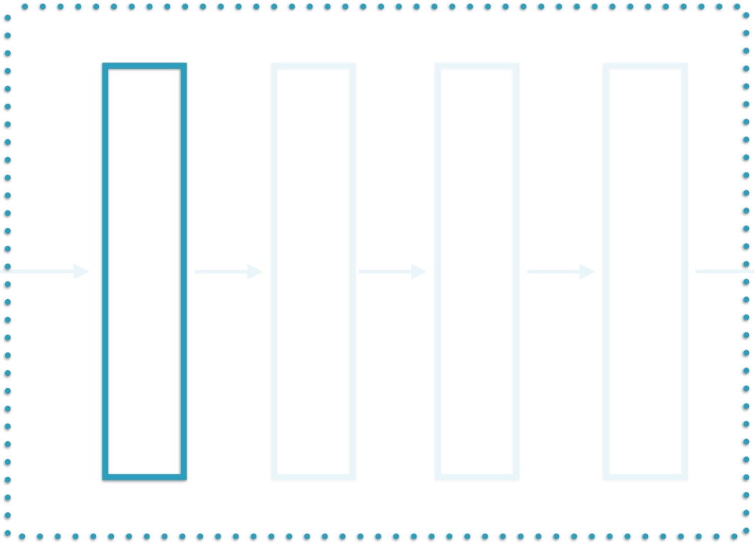


Image Recognition Using Neural Networks
Pixels
Edges
Corners
Object Parts
Corpus of
Images
“Visible
layer”
ML-based Classifier

Slide 10
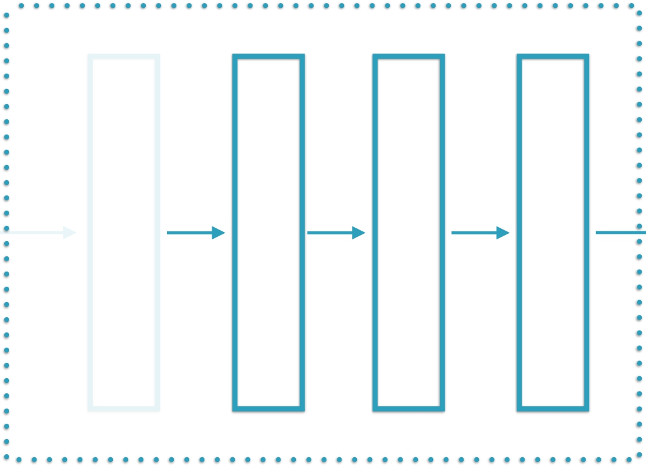
Image Recognition Using Neural Networks
Pixels
Edges
Corners
Object Parts
Corpus of
Images
“Hidden
Layers”
ML-based Classifier

Slide 11
Neural Networks Introduced
Layer 1
Layer 2
…
Layer N
Corpus of
Images
Layers in a neural network
ML-based Classifier

Slide 12
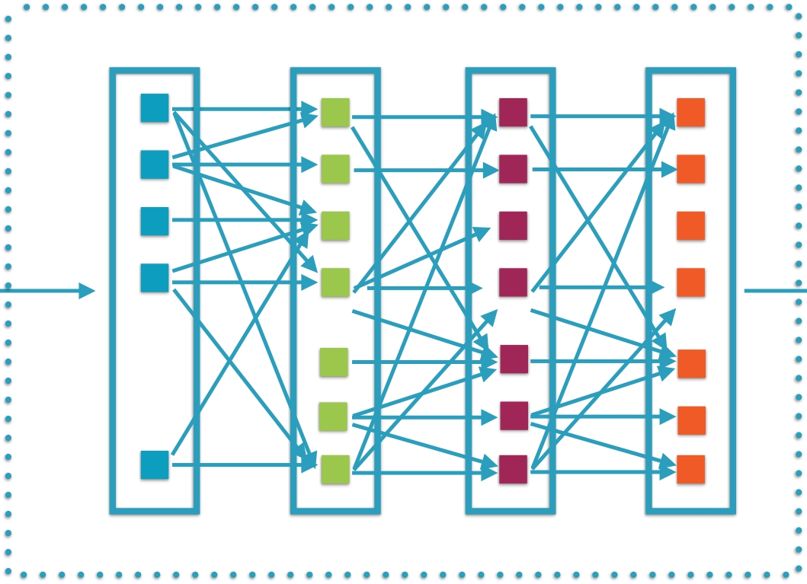
Neural Networks Introduced
…
Pixels Processed groups of pixels
Each layer consists of individual
interconnected neurons
Corpus of
Images
ML-based Classifier

Slide 13
TensorFlow is optimized at
building neural network
solutions for image recognition

Slide 14
Representing Images as 3-D Tensors

Slide 15

Images as Tensors

Slide 16

Images as Tensors
Each pixel holds a value based on the type of image

Slide 17

RGB Images
RGB values are
for color images
R, G, B: 0-255

Slide 18
RGB Images
255, 0, 0

Slide 19
RGB Images
0, 255, 0

Slide 20
RGB Images
0, 0, 255
3 values to represent
color, 3 channels

Slide 21

Grayscale Images

Slide 22

Grayscale Images
Each pixel represents
only intensity information
0.0 - 1.0

Slide 23
Grayscale Images
0.5

Slide 24
Grayscale Images
0.5
1 value to represent
intensity, 1 channel

Slide 25


Images as Tensors
Single channel and multi-channel images

Slide 26


Images as Tensors
Images can be represented by a 3-D matrix

Slide 27
Images as Tensors
The number of channels specifies the
number of elements in the 3rd dimension

Slide 28
Images as Tensors
(6, 6, 1) (6, 6, 3)

Slide 29

Demo
Read in an image using matplotlib and then transpose it using TensorFlow

Slide 30
Read in a list of images in TensorFlow using a queue and coordinators
Resize images to be of the same dimensions
Show image summaries in TensorBoard
Demo

Slide 31
List of Images as 4-D Tensors

Slide 32

List of Images
TensorFlow usually deals with a list of
images in one 4-D Tensor

Slide 33
List of Images
The images should all be the same size

Slide 34

List of Images
(10, 6, 6, 3)
The number of channels

Slide 35
List of Images
(10, 6, 6, 3)
The height and width of
each image in the list

Slide 36
List of Images
(10, 6, 6, 3)
The number of images

Slide 37
Demo
Perform flip, crop and other transformations on images
Pack a list of images into one Tensor Display a list of images on TensorBoard

Slide 38
Summary
Understood image representation of color and grayscale images as Tensors
Learnt image transformations such as resize, flip and crop
Worked with multiple images in TensorFlow

